Slide 1

Discogs Album Database- More than 16 million releases Using Hadoop
By: Daniel Garrido, Sereyoudom Eab, Michael Miranda, Giovanni Munoz, Yana Polshyna, Uriel Guijarro

Slide 2
Abstract
Discogs, a prominent online music database and marketplace, offers a wealth of data for analyzing music trends across diverse genres, styles, and locations.
This analysis delves into the intricacies of Discogs' extensive collection to uncover insights into popular music preferences and industry dynamics.
By examining the frequency of releases and user engagement, we can identify the most popular genres and styles of music across different countries and release dates.
This analysis can reveal regional music preferences and the evolution of musical trends over time. In addition to that, analysis of this data is conducted using Excel, depicting visuals such as maps, timeline and charts on trends of music in different regions of the world
https://www.kaggle.com/datasets/ofurkancoban/discogs-releases-dataset

Slide 3
Discogs
This project uses Hadoop and Hive to keep and process Discogs offers a wealth of data that can be harnessed to analyze music trends across diverse genres, styles, and locations.
By exploring the popularity of genres, tracking release patterns, visualizing data geographically, determining popular distribution formats, examining industry trends, and identifying influential record labels, we can gain a deeper understanding of the ever-evolving landscape of the music industry and the factors that shape it.
We have chosen this dataset because it is a valuable resource for studying music trends. It is comprehensive, accurate, granular, and accessible, and it is relevant to a wide range of research questions.

Slide 4
Specification
The database is mostly to track and share music collections, provide information about music recordings, and facilitate the buying and selling of music recordings.
Since the database is too large and several of the fields appear to be unneeded or unsuitable for our research, we chose to include the 14 most significant columns, which includes:
ID: Unique Identifier
Release Date: The release year of the music
Release ID: This is the unique identifier for this particular music release
Status: Indicates that it has been accepted, showing that this item has a specific status
Title: The title of the music release
Artist ID: Artist ID of the album artist

Slide 5
Specifications Cont.
Label Name: This section specifies which music label released the music
Label ID: The label's catalog number
Format: This section details in which format the music is available
Genre: Indicates the genre of the music
Country: The country of origin for this music release
Company Name: This section includes information about companies involved in the production,
Style: Specifies the style or genre of the music
Artist Name: Artist name of the album artist
The databases currently contains 16 million recorded releases. This overall gave us 2GB of data.

Slide 6
Experimental Specifications
Number of Nodes | 3
OCPUs | 8
CPU speed | 1995.312 MHz
Memory | 58 gb

Slide 7
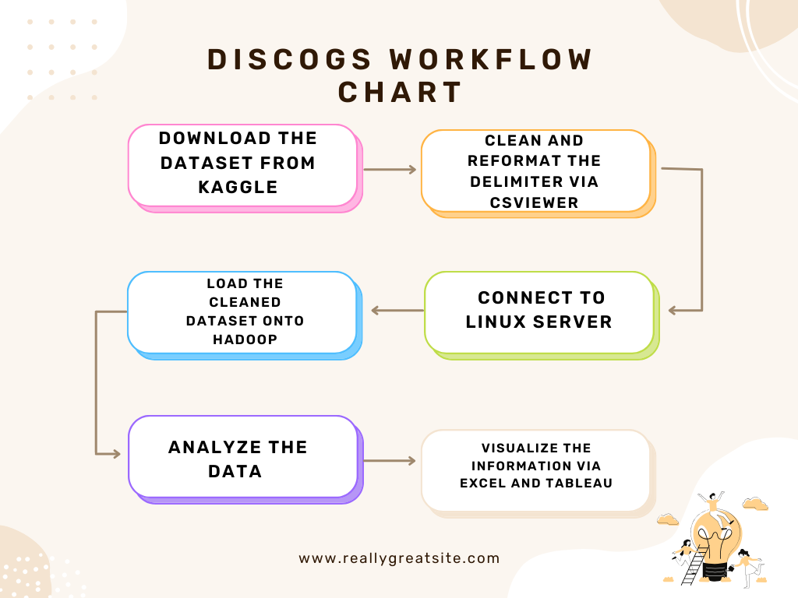
Workflow Chart

Slide 8
Data Cleaning
Making sure the data was ready for analysis was tedious. Luckily, we were able to use some viable resources and techniques to accomplish the cleaning process successfully.
The comma delimiter created separation issues since commas were found within data entries, so we had to find a delimiter that was more unique. We figured Pipe ' | ' was a better option.
Though pipe was also found within data entries, it was less frequent and deleting the character would not affect the integrity of the data.
We first uploaded the entire file onto Linux server and used Bash to delete all the pipe characters in the file, then copied the file back to local storage.
We utilized CSViewer to get rid of unnecessary columns and modify the file to use pipe as the new delimiter.
Now that we're sure pipe character is only used as the delimiter, our data is clean of separation issues, and we could begin to create tables with consistent and accurate data.

Slide 9
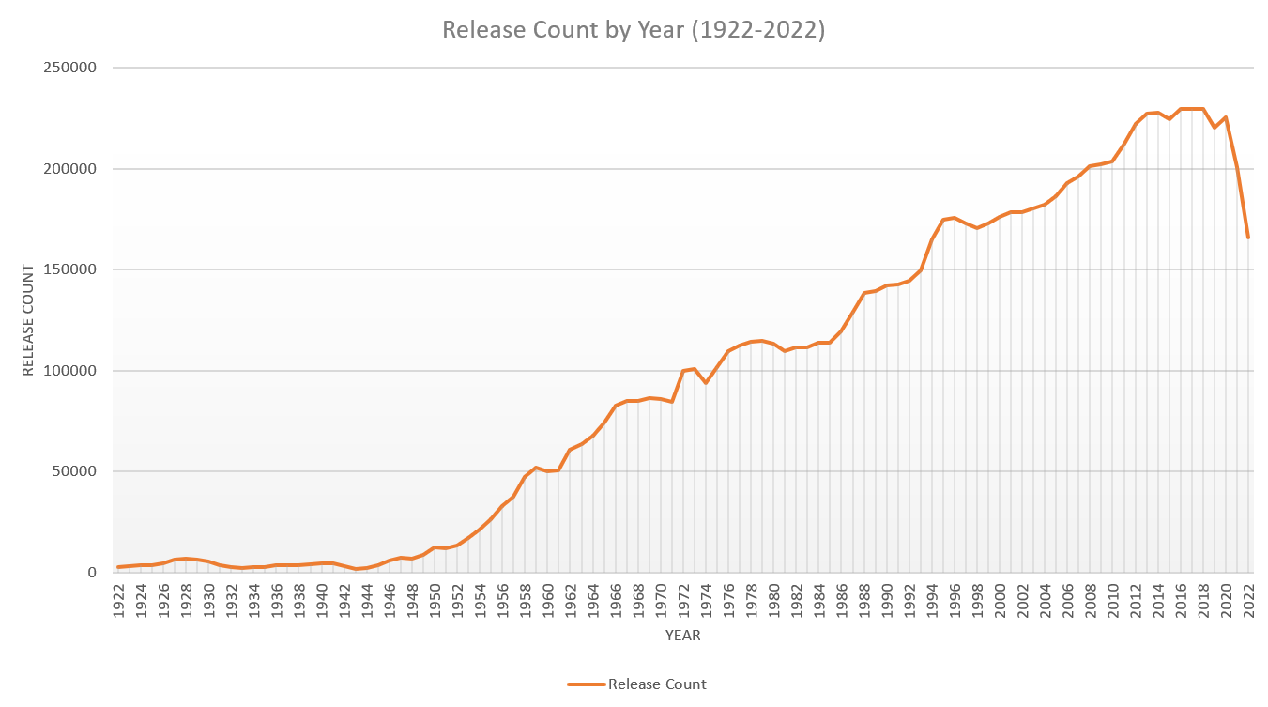
Visualization 1

Slide 10
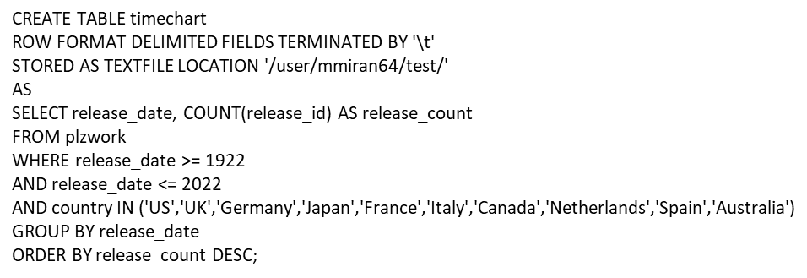
Visualization 1 Code

Slide 11
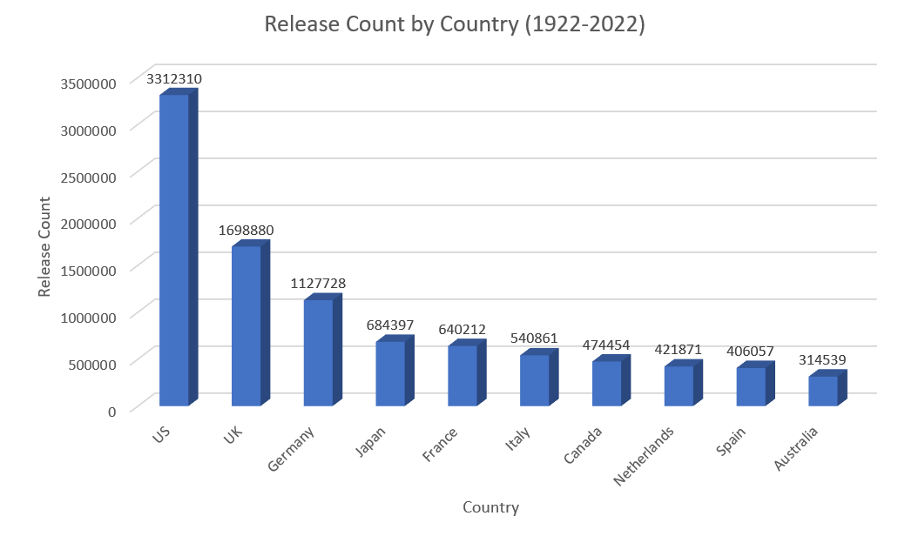
Visualization 2

Slide 12
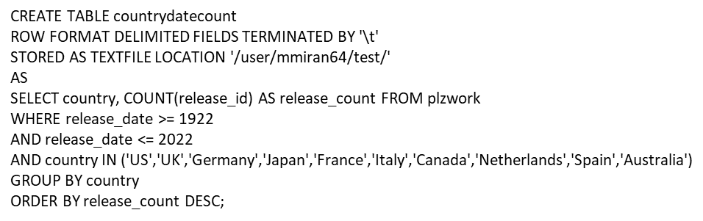
Visualization 2 Code

Slide 13
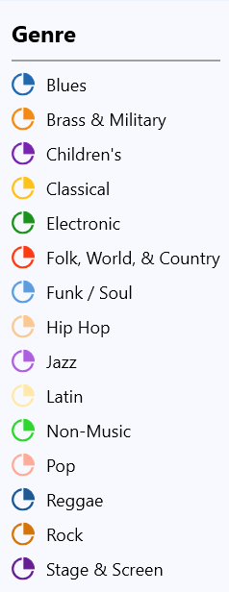
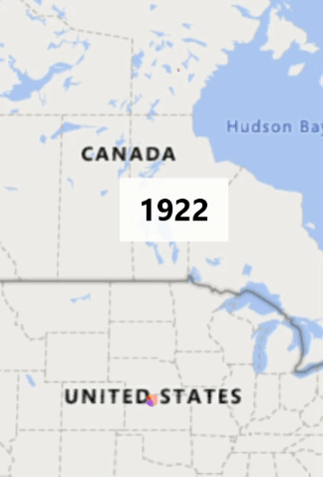
Visualization 3

Slide 14
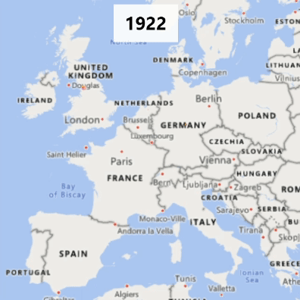
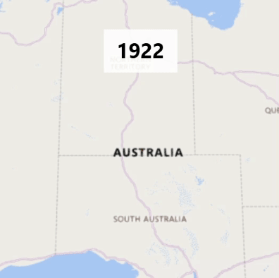
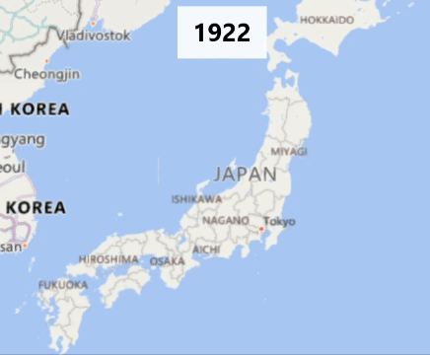
Visualization 3 Cont.

Slide 15
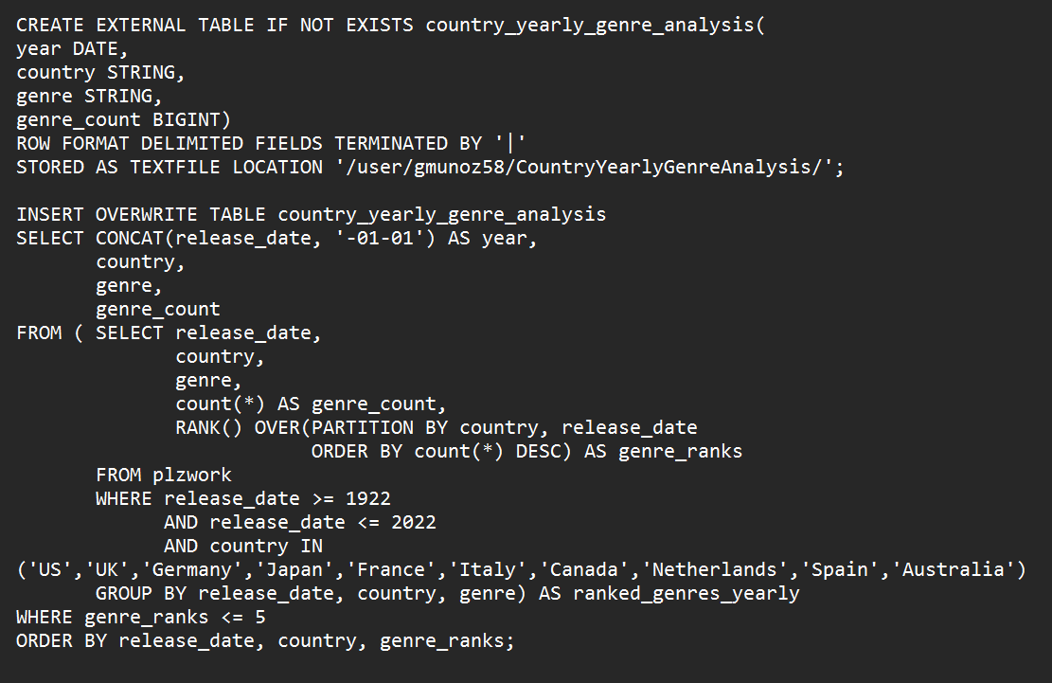
Visualization 3 Code

Slide 16
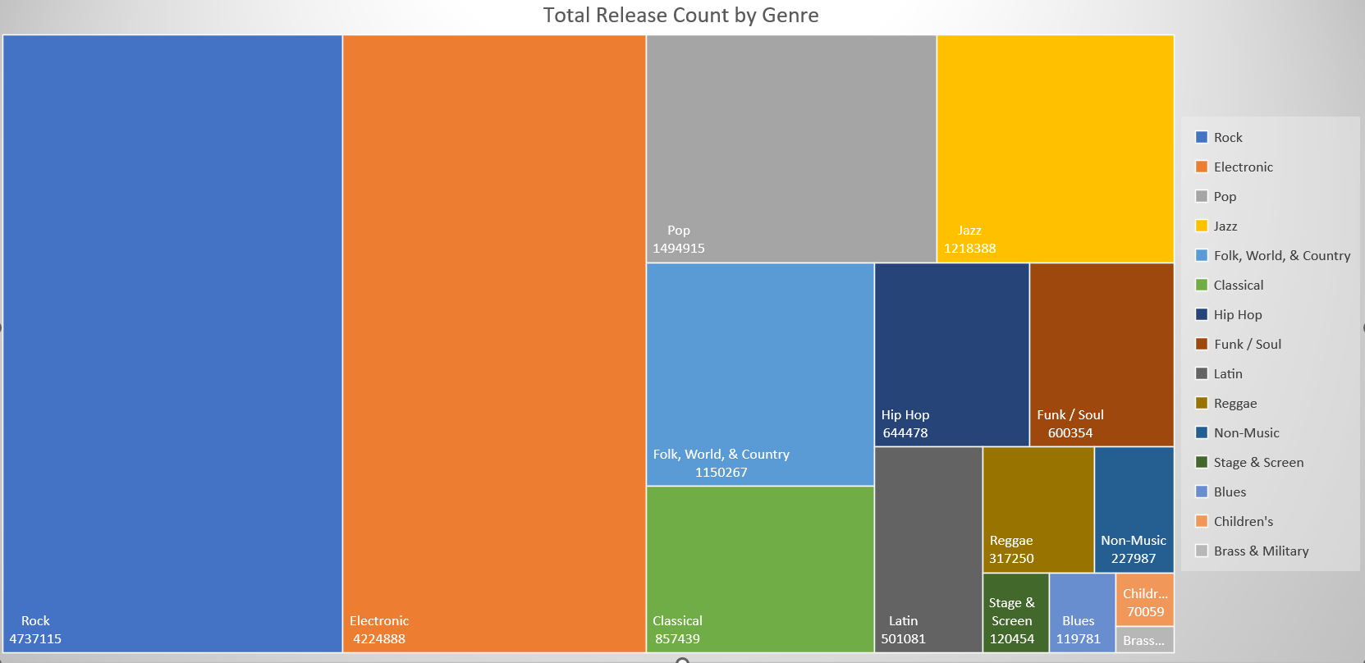
Visualization 4

Slide 17
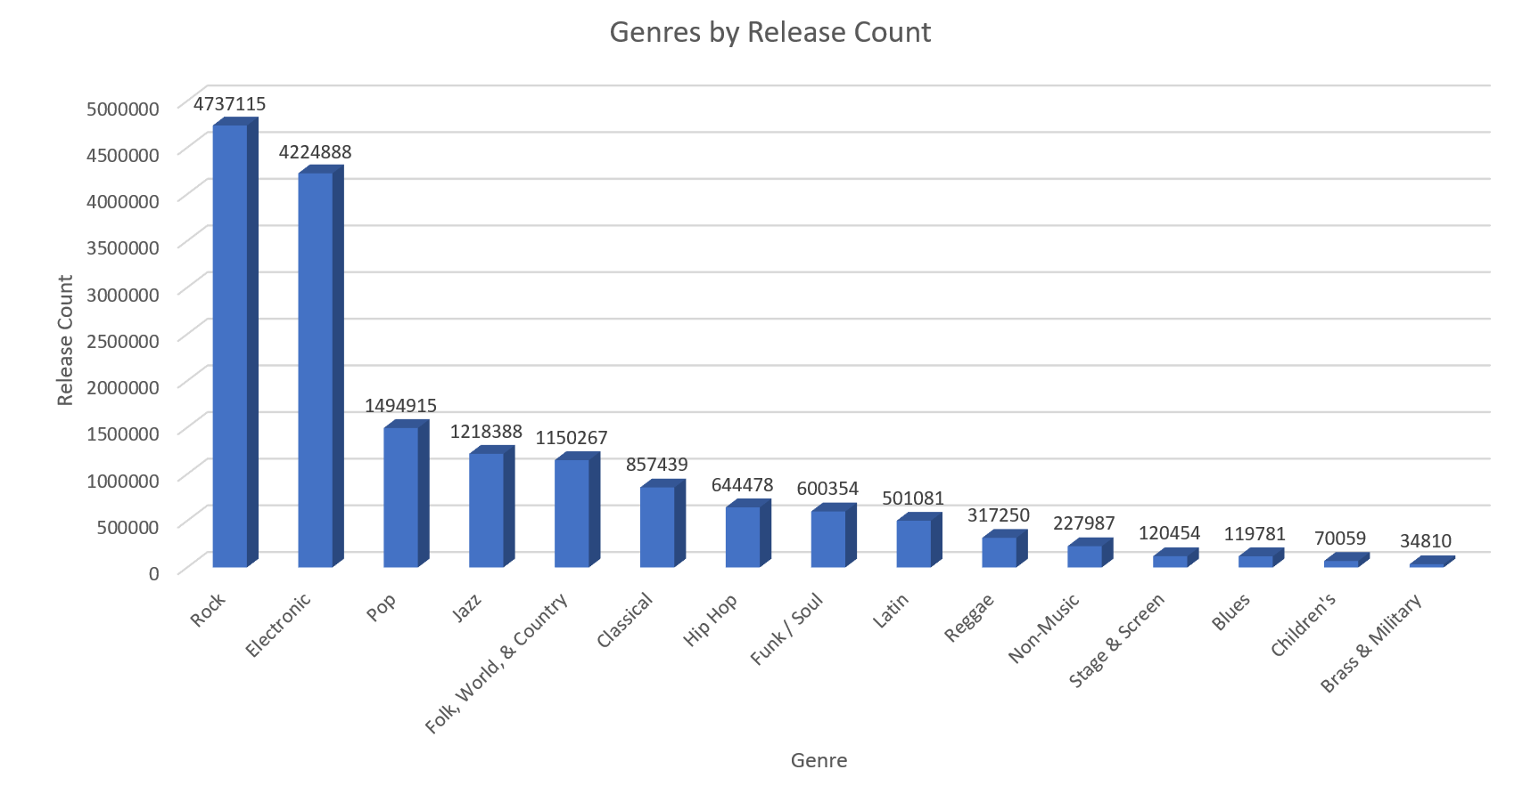
Visualization 4 Cont.

Slide 18
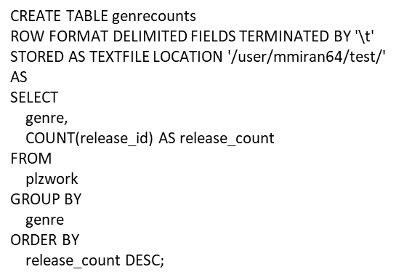
Visualization 4 Code

Slide 19
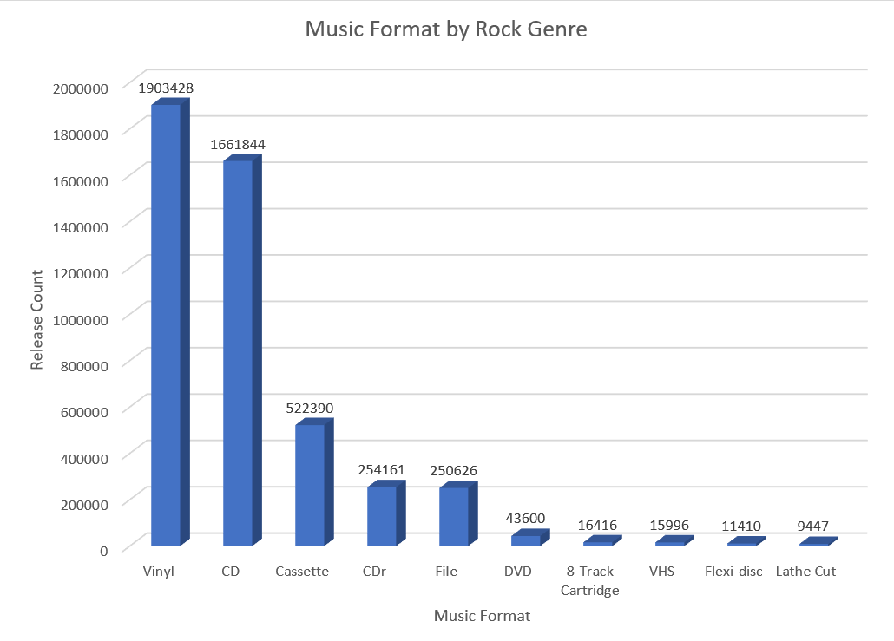
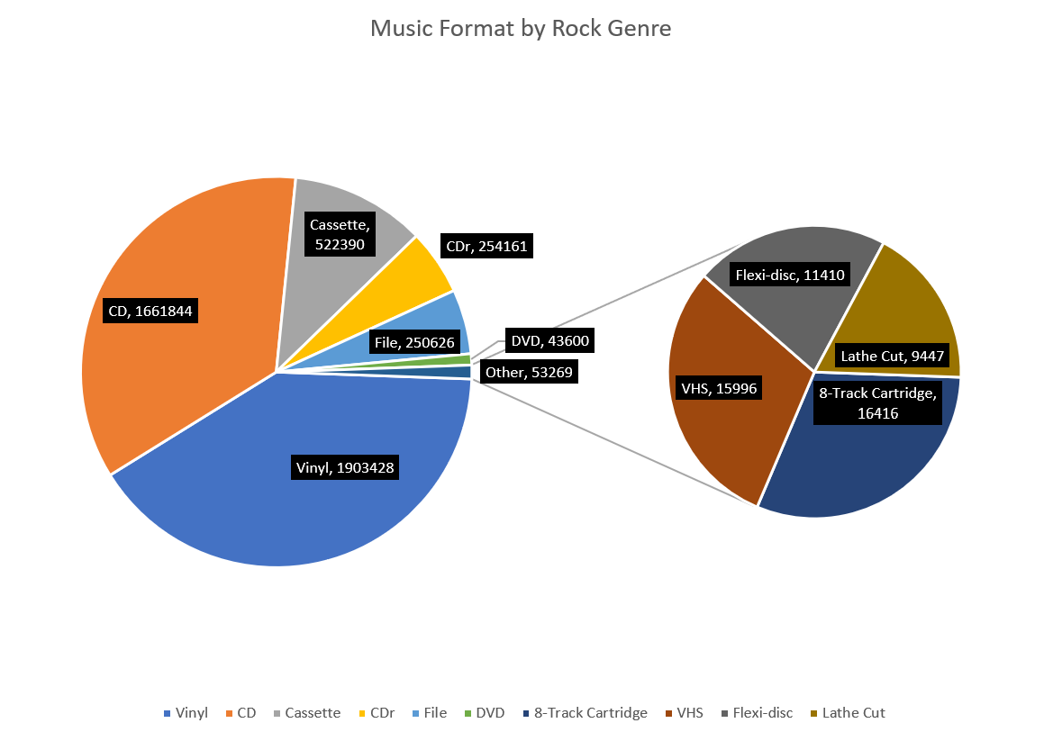
Visualization 5

Slide 20
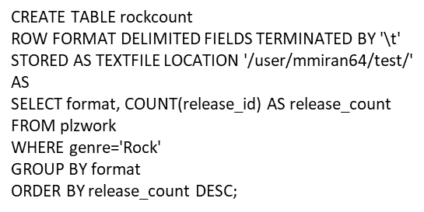
Visualization 5 Code

Slide 21
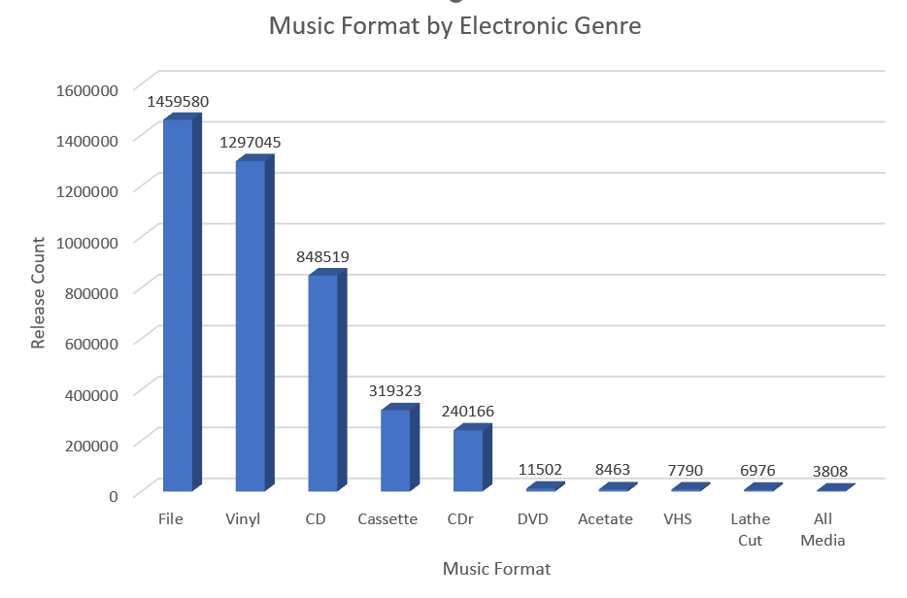
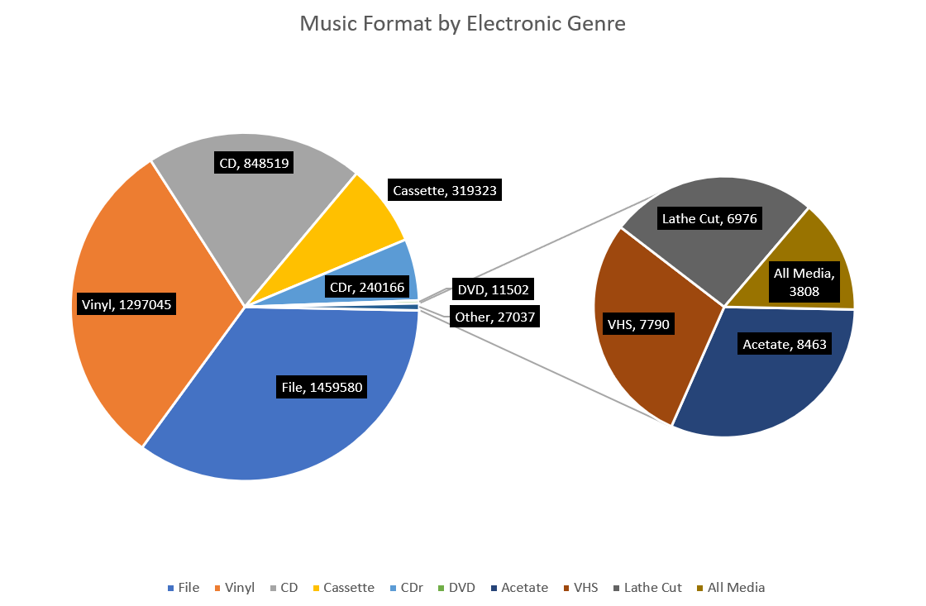
Visualization 6

Slide 22
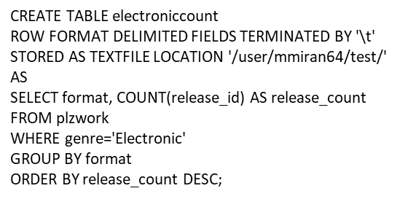
Visualization 6 Code

Slide 23
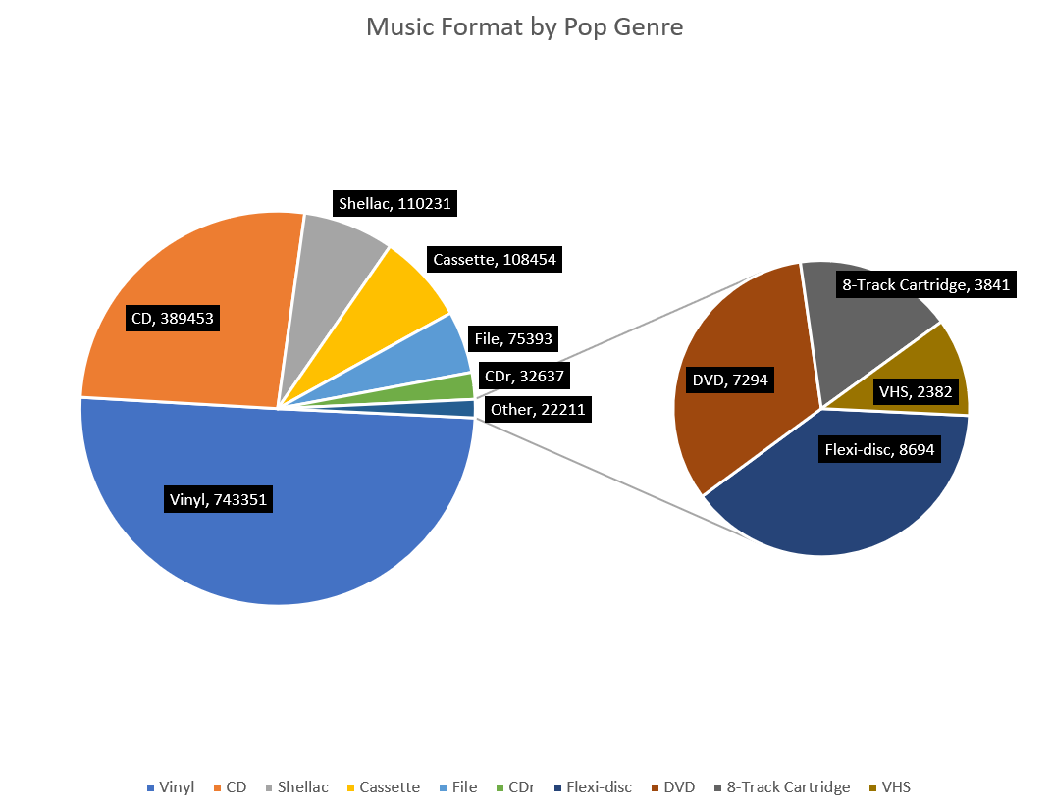
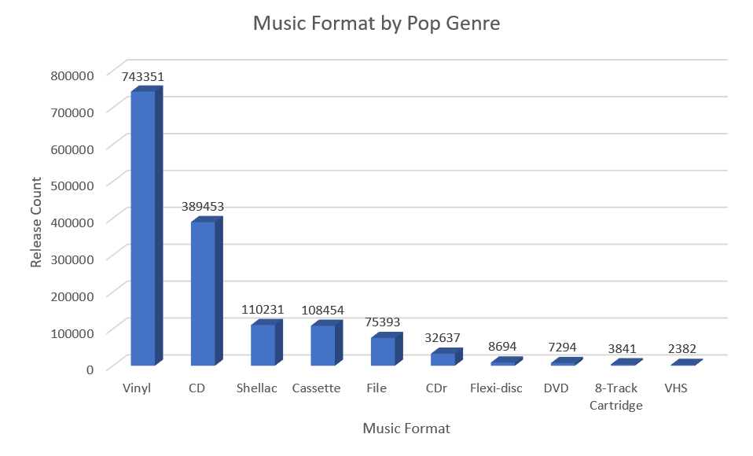
Visualization 7

Slide 24
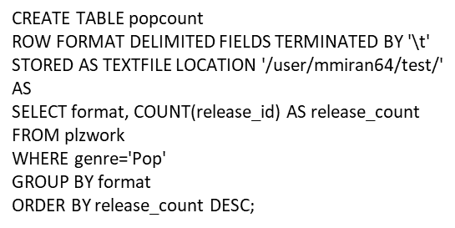
Visualization 7 Code

Slide 25
For More Info:
Access to the database:
https://www.kaggle.com/datasets/ofurkancoban/discogs-releases-dataset
GitHub Codes/Slides:
https://github.com/danielgarrido1/Term-Project-Abstract-Discogs

